Slide 1
Semifrontal

Slide 2
failure

Slide 4
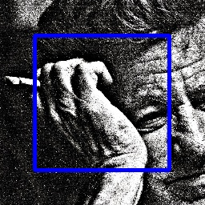

Slide 5
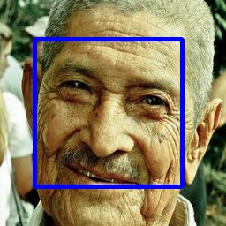

Slide 6
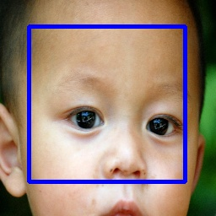

Slide 11
good

Slide 16
profile

Slide 17
failure

Slide 23
good

